Slide 1
Hello Flutter
neevash Ramdial

Slide 2

Neevash Ramdial
@Nash0x7e2 Everywhere :)
Mobile Developer @ Junto
Lead Editor @ Flutter Community
Software Engineering Student @ UTT
HackTT 2019 Winner

Slide 3


So you want to build an App...
Scenario:
Need to build an app
It has to be released on both Android and iOS
Performance
Within budget

Slide 4
You have a
few Options

Slide 5
1) Two Native Apps

Slide 6


Option One: Separate Native Apps
Performance
Designed for each platform
Familiar UX
Expensive
Needs to be written twice
Double the maintenance

Slide 7

Icons by Flat Icons https://www.flaticon.com/authors/flat-icons

Slide 8

Two birds one stone?

Slide 9
2) Traditional Cross platform

Slide 10



Option Two: Cross Platform Approaches
Lots of Javascript packages and libs
Save time and money
Easier to maintain
Native Script
Ionic
React Native

Slide 11
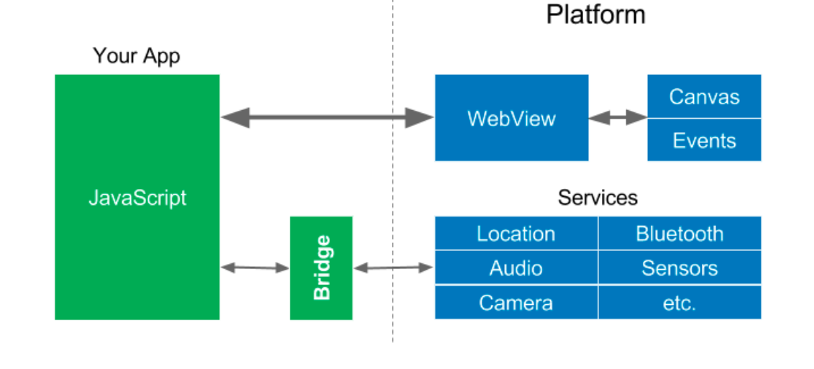
Hybrid/Webview

Slide 12
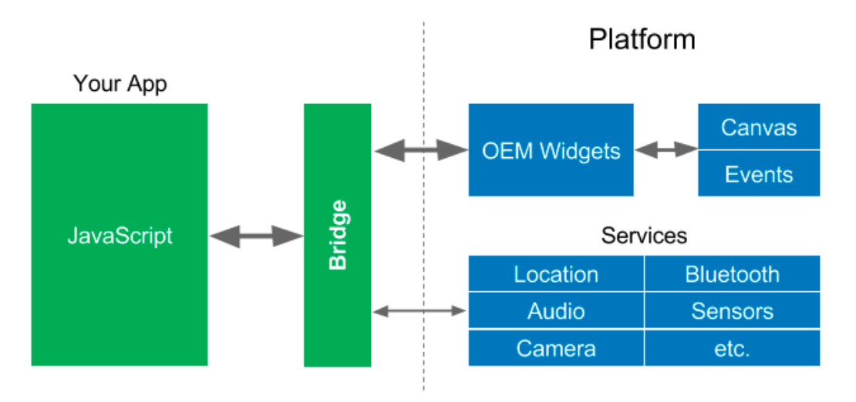
Reactive Approach

Slide 13
Option Two: Cross Platform Approaches
Performance isn't great
Bridges and proxies are required
Tied to OEM widgets
Native services are not easily accessible

Slide 14

Flutter

Slide 15


What is Flutter?
UI toolkit made by Google
Runs on Android and IOS (web and desktop in development)
Performance
Great tooling and developer experience
Also allows for calling native code when necessary

Slide 16


Slide 17
Deeper Look

Slide 18
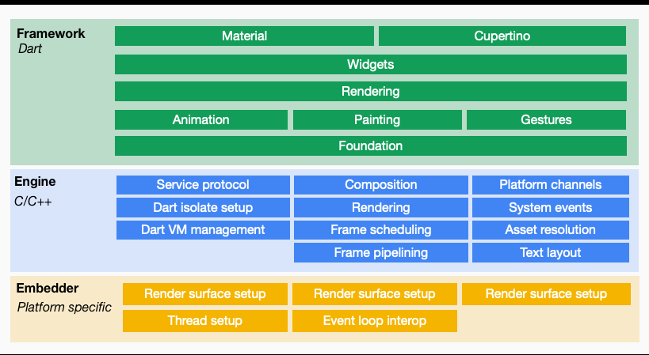
Flutter Breakdown

Slide 19
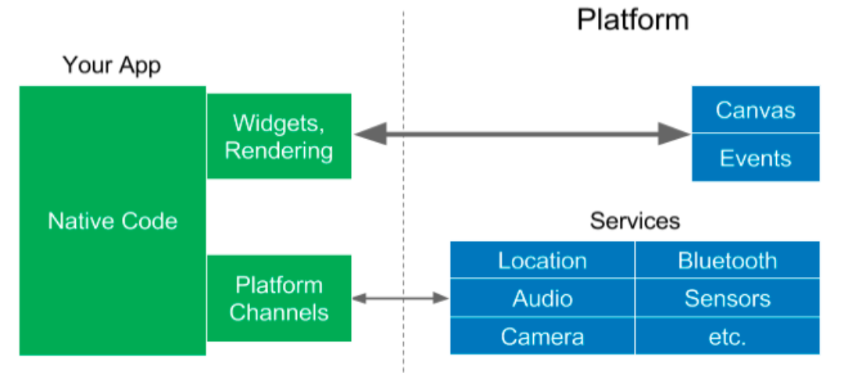
Flutter Breakdown

Slide 20
Flutter Advantages
Silky smooth 120 FPS animations/UI
Small app size
High developer productivity
Runs directly on the metal
Ships with it's own runtime

Slide 21
Example
class CoolLogo extends StatelessWidget {
@override
Widget build(BuildContext context) {
return Scaffold(
child: Center(child: FlutterLogo(),
),
);
}
}

Slide 22
Example
Name
Widget type
class CoolLogo extends StatelessWidget {
@override
Widget build(BuildContext context) {
return Scaffold(
child: Center(child: FlutterLogo(),
),
);
}
}
Build Method:
All widgets contain a build method.
Describes the user interface created by the widget. It is made up of other widgets.

Slide 23
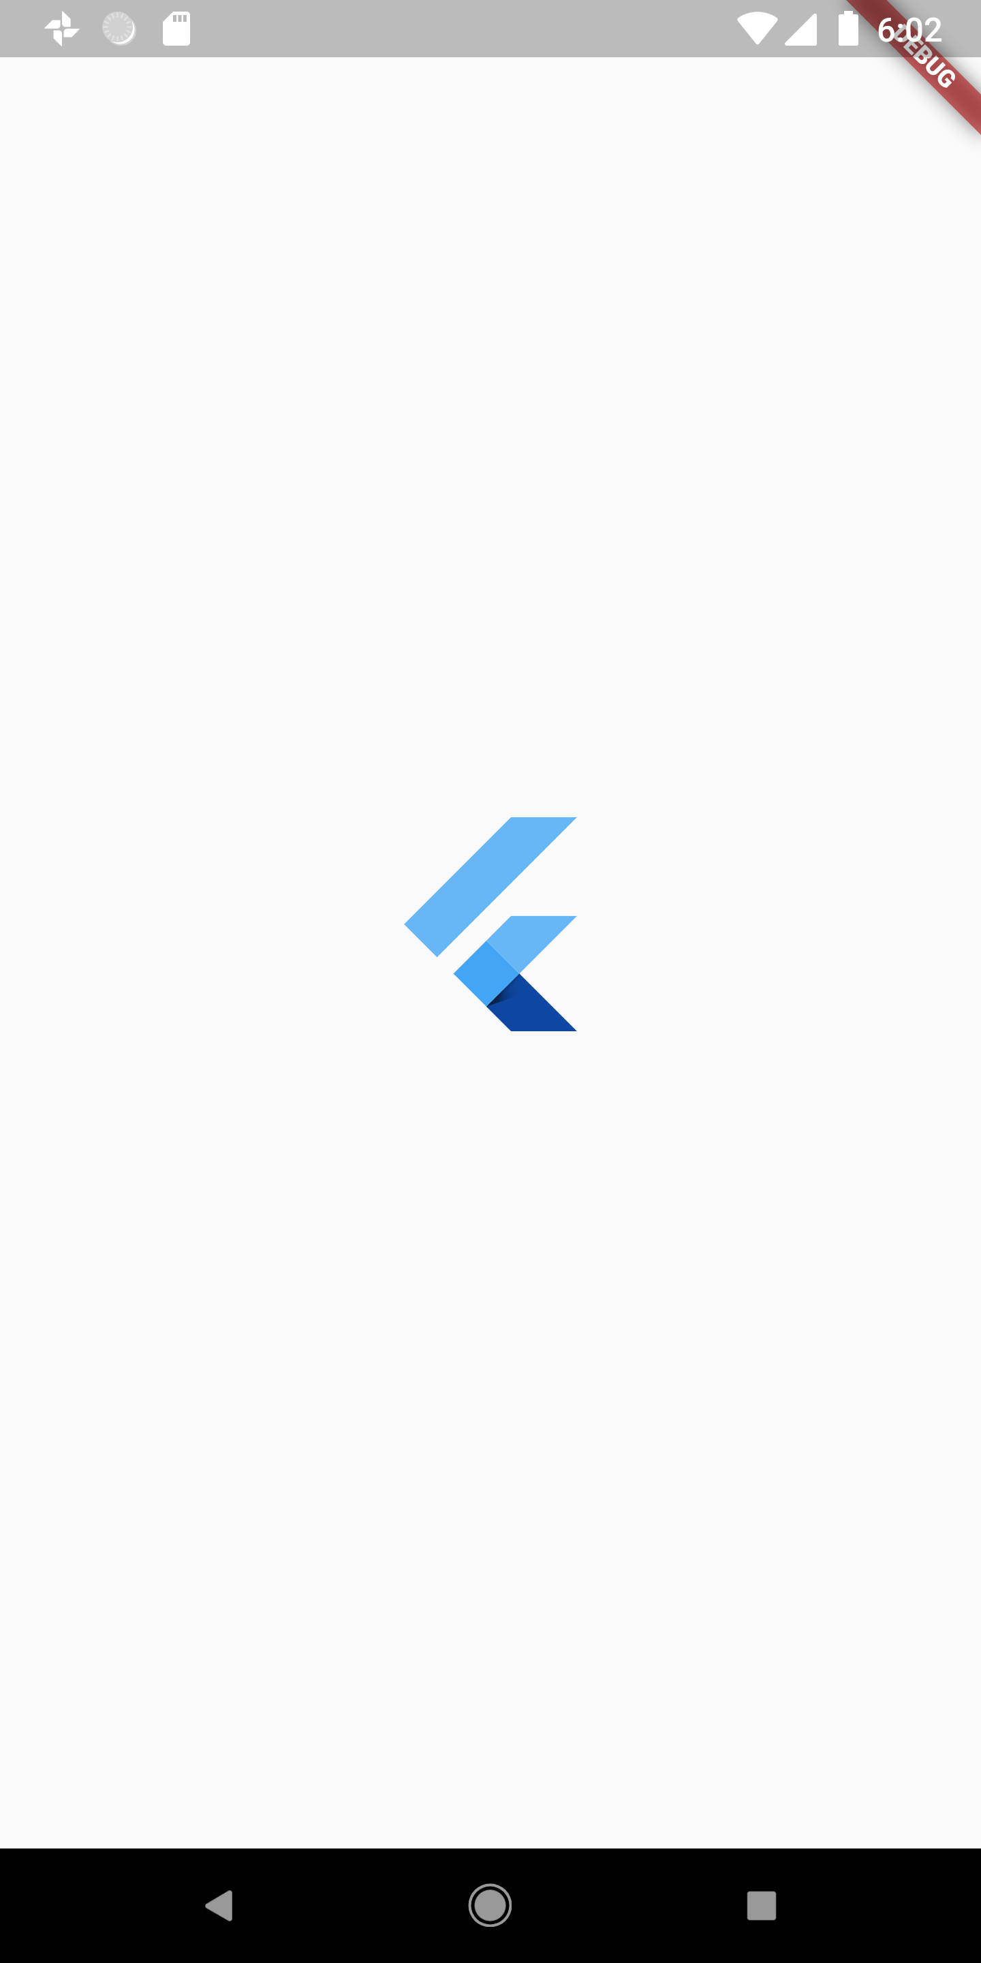
Example

Slide 24

Dart
"Dart is a client optimized language for building native apps on mobile, web and server."
Compiles using both JIT and AOT
Enables Flutter's "Hot Reload"
Able to compile to Javascript along with native binary
Can be used to on the backend and servers
Supports modern programming features like async/await and non nullable types soon
Dart

Slide 25

Dart: The Nerdy Stuff
Tree Shaking Compiler
Your app ships with the Flutter framework and your UI Widgets built in, but the compiler strips out anything you don’t use so it helps keep the app size down.
Isolates
Dart version of threads. Unlike threads, isolates do not share memory. It is a private space on device which contains a single thread running an event loop.
Dart

Slide 26
Example: Updating UI
class _ClickyState extends State<Clicky> {
@override
Widget build(BuildContext context) {
return Scaffold(
body: Center(
child: Text('Someone Clicked me $_click times'),
),
floatingActionButton: FloatingActionButton(
onPressed: _onButtonPressed,
),
...
The key difference in this example is we have a
"Stateful" widget. In other words, our widget can change.
Data defined in the a Stateful widget can be mutated and used
to update out UI
String interpolation :)
Call a method defined outside our build method
which mutates out data

Slide 27
Example: Updating UI
void _onButtonPressed() {
setState(() => _click++);
}
Function return type, in our case we are not returning
any data so "void" is used.
The Magic! "setState" is a function available to us from
within Stateful widget. When called, the existing widget
tree is destroyed and rebuilt. The callback function passed to
setState is also executed.
In our case, we use a lambda to increase the value of our
count variable "_click" by one.

Slide 28

Example: Updating UI

Slide 29
Demo

Slide 30
Resources:
Flutter
Github: https://github.com/flutter/flutter
Twitter: twitter.com/FlutterDev
Flutter Community
Medium: https://medium.com/flutter-community
Twitter: https://twitter.com/FlutterComm
Keep in touch:
Twitter: https://twitter.com/Nash0x7E2
Medium: https://medium.com/@Nash0x7e2
Github: https://github.com/Nash0x7e2

